Slide 1
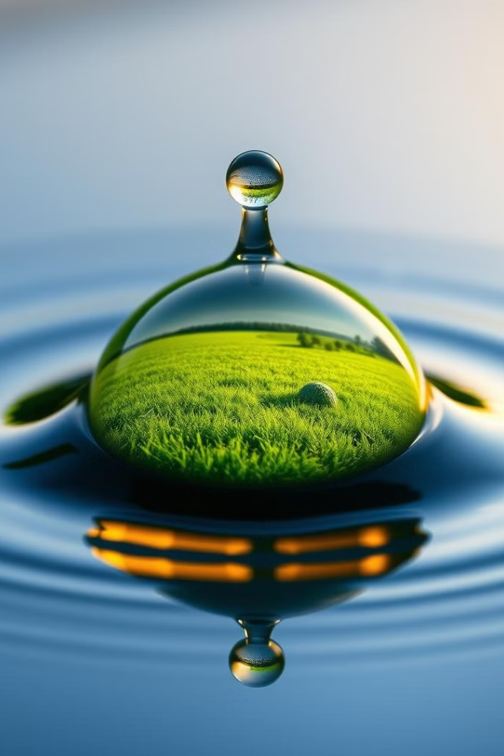

Water Conservation: Ensuring a Sustainable Future
Water conservation is crucial for our planet's future. This project, led by Dhiraj, Akash, and Dhanush under Dr. N. Nanthini's guidance, explores sustainable practices. We'll dive into conservation techniques, benefits, and ways to promote responsible water use.
by Akash

Slide 2

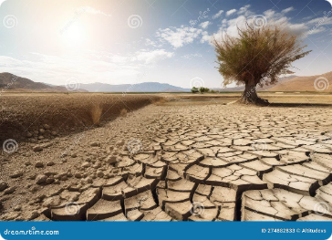
Introduction to Water Conservation
1
Resource Depletion
Growing populations and climate change strain our water supplies. Conservation is no longer optional; it's essential.
2
Conservation Techniques
We'll explore methods like rainwater harvesting and efficient irrigation. These practices can significantly reduce water waste.
3
Community Impact
Our project aims to inspire sustainable habits. Small changes can lead to substantial collective impact.

Slide 3

Our Conservation Efforts
1
Rainwater Harvesting Analysis
2
Efficient Irrigation Techniques
3
Daily Habit Awareness
We identified common wasteful practices like leaving taps running. Simple habit changes can save thousands of liters annually.
We studied various harvesting systems, from simple rain barrels to complex filtration setups. These methods can reduce reliance on municipal water supplies.
Drip irrigation and smart sprinkler systems were explored. These can reduce water usage by up to 50% compared to traditional methods.

Slide 4
Project Outcomes
Practical Knowledge
Community Engagement
Global Perspective
We gained hands-on experience with conservation techniques. This included building small-scale rainwater harvesting systems and conducting water audits.
Our team organized workshops and demonstrations. We learned effective ways to communicate complex ideas to diverse audiences.
Research into worldwide water issues broadened our understanding. We realized the interconnectedness of local actions and global impacts.

Slide 5
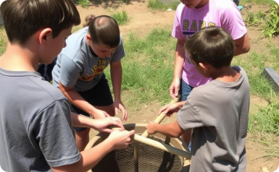
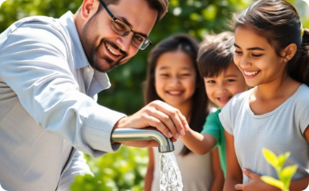

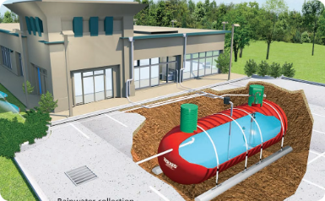

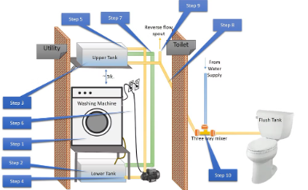
Project Highlights
Water Level Monitoring
Grey Water Recycling

Slide 6
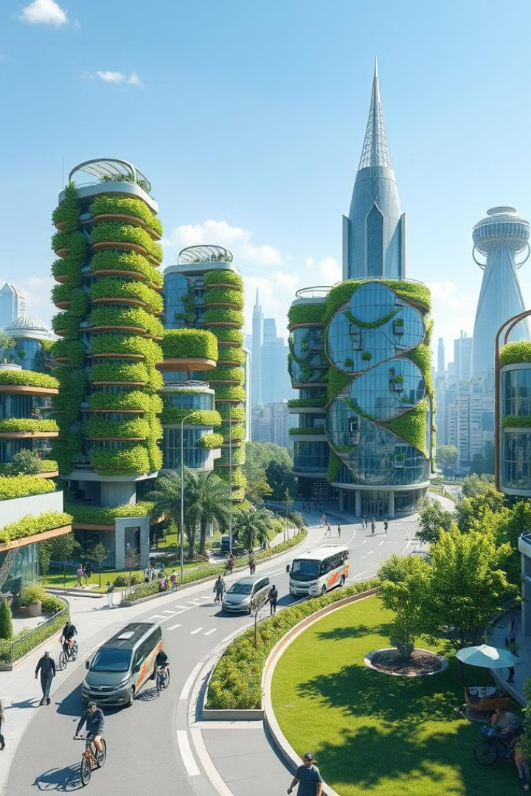



CONCLUSION
Individual Action
Small changes can make a big difference. Everyone can contribute to water conservation in their daily lives.
Community Engagement
Our project has ignited local interest. We hope to see more community-led conservation efforts in the future.
Global Impact
By conserving water locally, we contribute to a sustainable future for the planet.

